Slide 1

Network Intrusion Detection System
Team-qt.py

Slide 2
Index
Team
Problem Statement and Introduction
Dataset Overview and Preprocessing
EDA
Classification techniques
Models used
Results and analysis
Business Model
Challenges Faced
Future Enhancements

Slide 3






Team
Veydant Katyal
ML and DL implementation
Spurthi Bhat
Data Preprocessing and ML implementation
Vishal RS
R&D and Business Implementation
Shreya Sethu
EDA and Analysis
Noorul Hassan
Dataset review and EDA
Aarav Patel
EDA and R&D

Slide 4
Problem Statement
What are we trying to build?
Scalable Network Intrusion Detection System that-
detects and predicts network intrusions in real time.
includes a binary classification model that classifies network intrusions as benign or attack
Expand the model to include multi-class classification that classifies networks into 4 distinct categories which include benign, portscan, DoS and DDoS attacks, with a variation on feature selection using decision trees to incorporate XAI.

Slide 5

Problem Statement
Why?
Businesses require network intrusion detection to protect sensitive data, systems and operations from unauthorized access or cyberattacks.
These could lead to potential financial losses, reputational damage and legal issues.
By identifying and responding to potential threats, companies can maintain their network security and ensure business continuity.

Slide 6
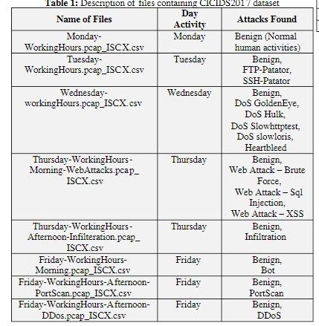
Dataset Overview
The CIC-IDS 2017 dataset is a comprehensive dataset for intrusion detection system (IDS) research. It was developed by the Canadian Institute for Cybersecurity (CIC)
Dataset Source | CIC-IDS2017 (https://www.unb.ca/cic/datasets/ids-2017.html)
Size | 2.3 million entries across 8 csv files. Reduced down to 20000 entries.
Description | 79 features. Consists of null, infinite and duplicate values. High class imbalance.

Slide 7
Classification Techniques
Binary Classification
  Simpler decision boundary
  Focuses on detecting malicious traffic
Multiclass Classification
  Requires more granularity to distinguish between attack types
  Focuses mainly on Portscan, DoS, DDoS and Benign
Multiclass Classification with Explainable AI
  Finer feature selection through importance scores calculated through decision trees

Slide 8
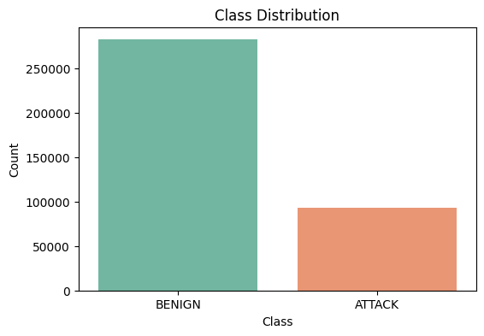
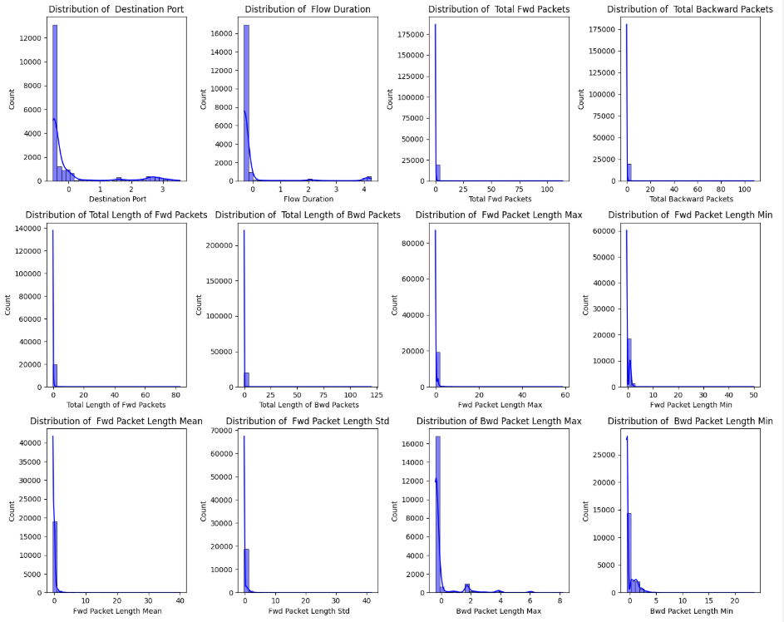
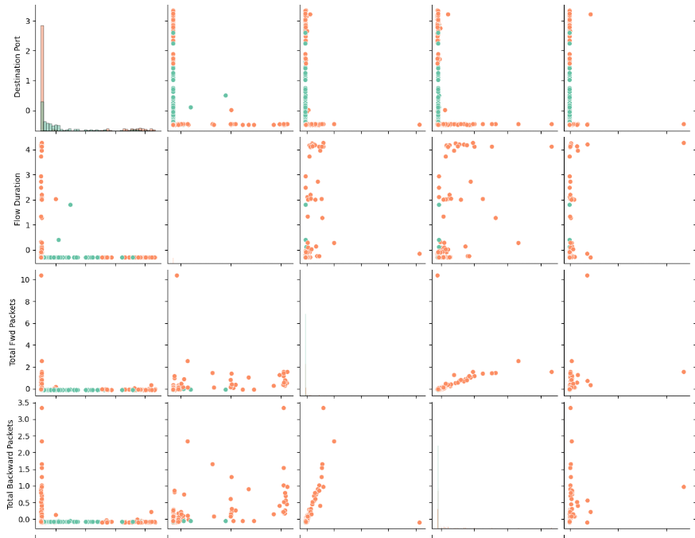
EDA
Binary Classification

Slide 9
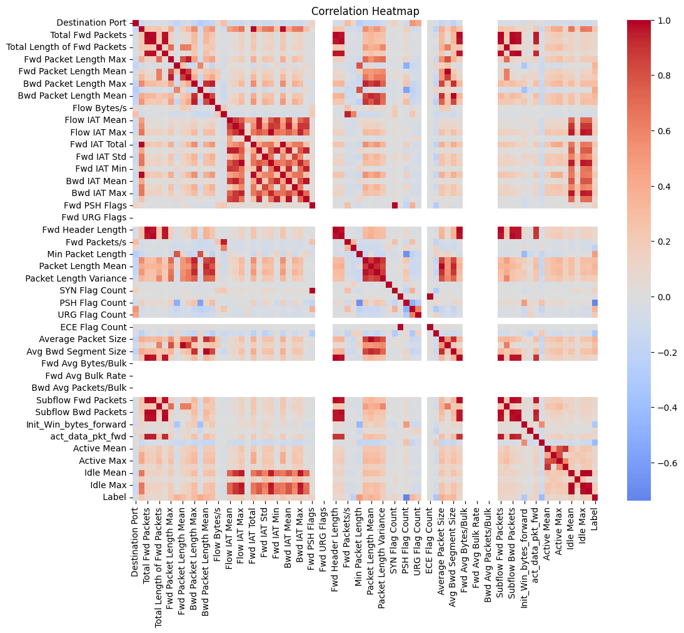
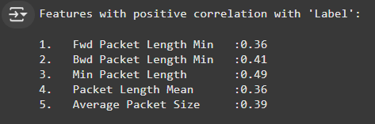
Binary Classification- Correlation

Slide 10
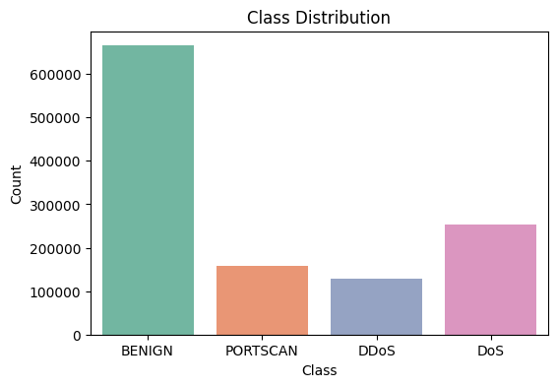
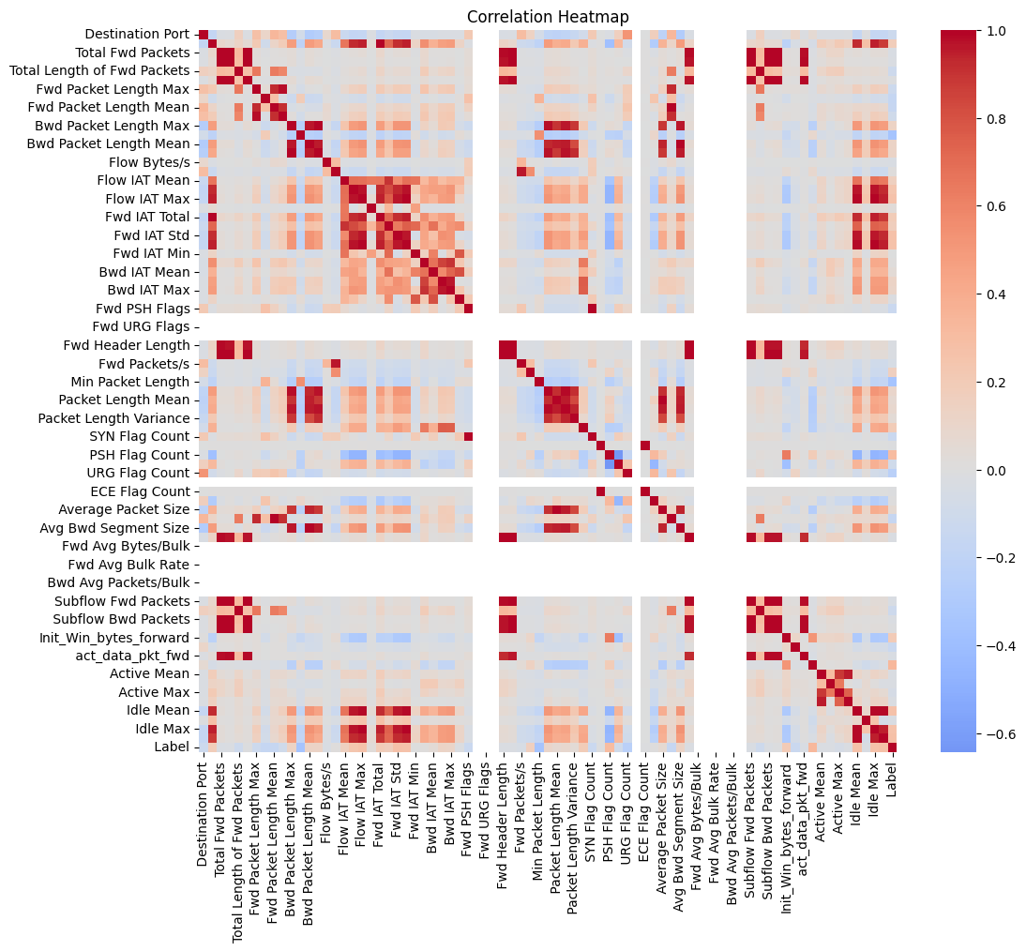
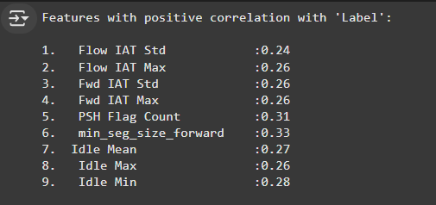
EDA
Multiclass Classification

Slide 11

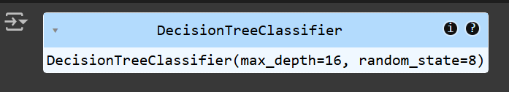
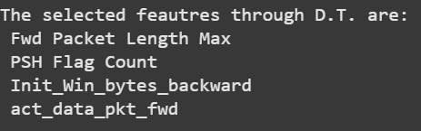
EDA
Multiclass Classification with XAI using Decision Trees

Slide 12
Models Used
To make our NIDS more robust and accurate, we have used ML as well as DL models to obtain the best possible accuracy, alongwith a comparative analysis to judge and identify the best models for our classification and detection task.
ML models-
Logistic Regression
Random Forest
K-Nearest Neighbours
Support Vector Machine
Naive Bayes
Gradient Boost
DL models-
1D CNN
LSTM
ANN

Slide 13
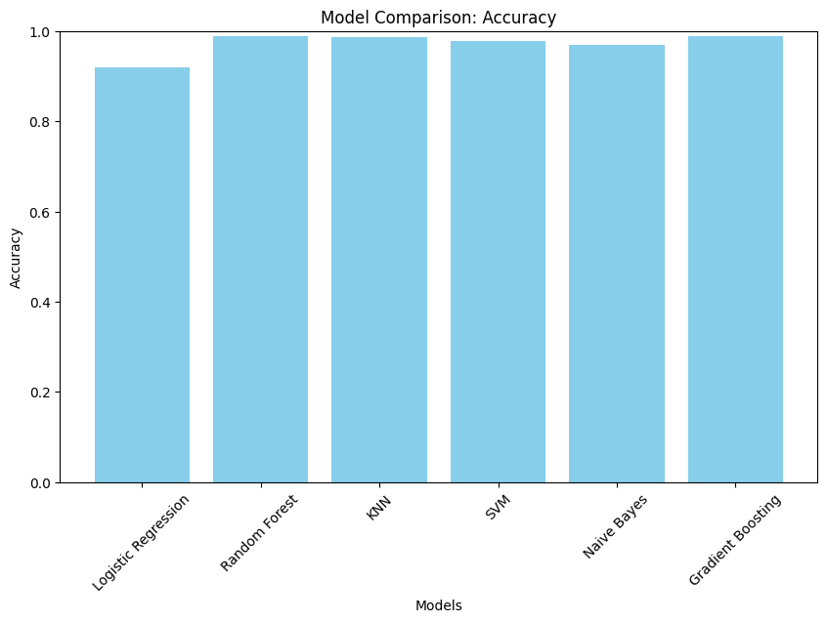
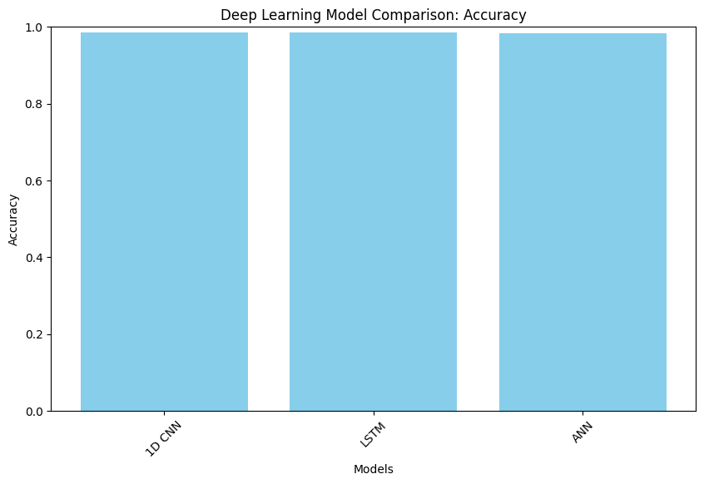
Comparative Analysis- Binary Classification
ML MODELS
DL MODELS

Slide 14
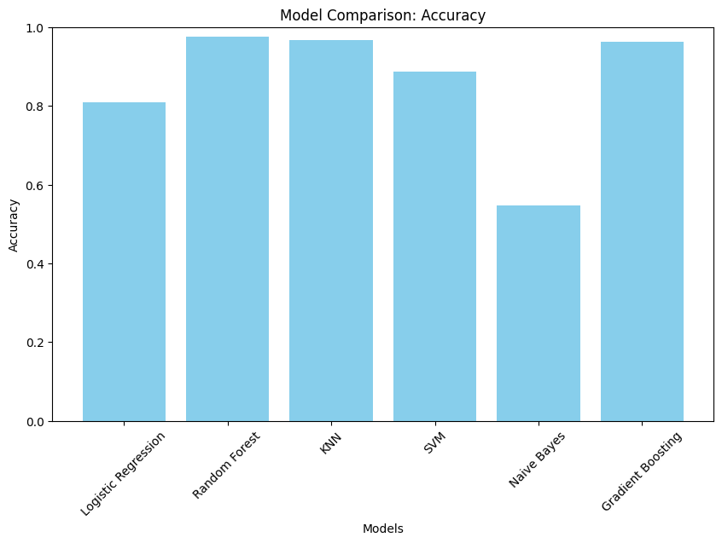
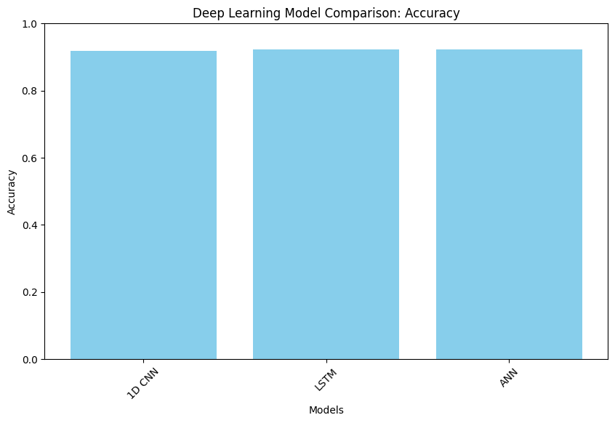
Comparative Analysis- Multiclass
ML MODELS
DL MODELS

Slide 15
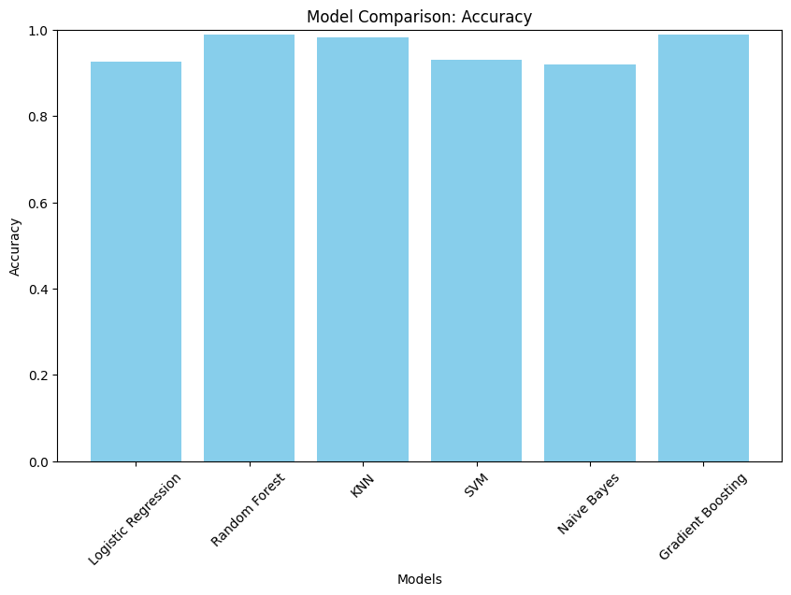
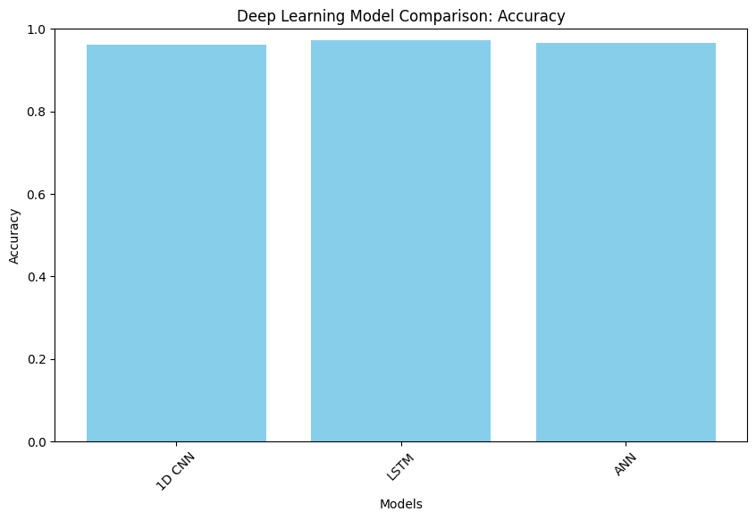
Comparative Analysis- Multiclass with Explainable AI
ML MODELS
DL MODELS

Slide 16
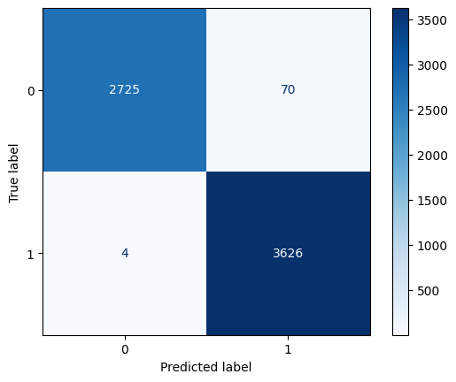

Results and Analysis
Multiclass Classification-
Best ML model
Random Forest- 97.56%
Best DL model
LSTM- 92.26%
Multiclass Classification with Explainable AI-
Best ML model-
Random Forest- 98.78%
Best DL model-
LSTM- 97.18%
Binary Classification-
Best ML model
Random Forest- 98.85%
Best DL model
LSTM- 98.52%

Slide 17
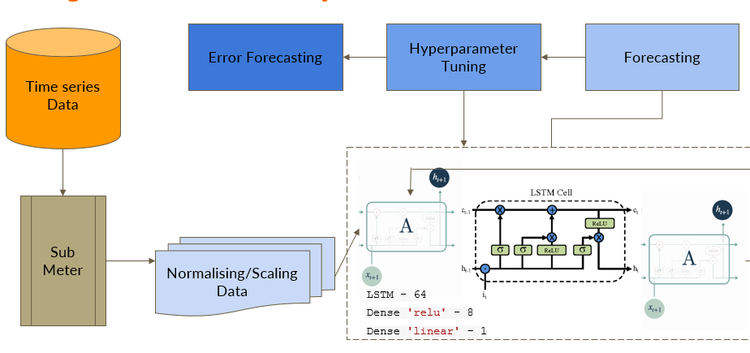
ARCHITECTURE DIAGRAM
LSTM-MULTICLASS USING D.T.(~98% Accuracy)

Slide 18
Business Model
Value Proposition
A highly accurate ML / DL powered Network intrusion detection model which not only classifies on a binary but multiple class classification level as well
Key Features
Real time threat detection
Advanced reporting and analytics for network administration
Scalable for small and large business enterprises
Benefits
Early detection of malicious activities it prevent breaches
Reduced cybersecurity operational costs

Slide 19
Revenue Model
SaaS based monthly/ yearly subscription service, along with a
Pay as you go service based on amount of network traffic volume,
Custom model training for specific threat detection and use cases.
Variable costs include the costs levied by the cloud servers for real time analysis model’s updates and maintains
The cost benefit for businesses would be the reduced cost to hire personnel to help debug cyber security issues as the NIDS can effectively detect traffic anomalies

Slide 20
Challenges Faced
Data preprocessing- smote analysis and downsampling
Efficient feature extraction
Possibility of model overfitting especially in binary classification
Hyperparameter tuning

Slide 21
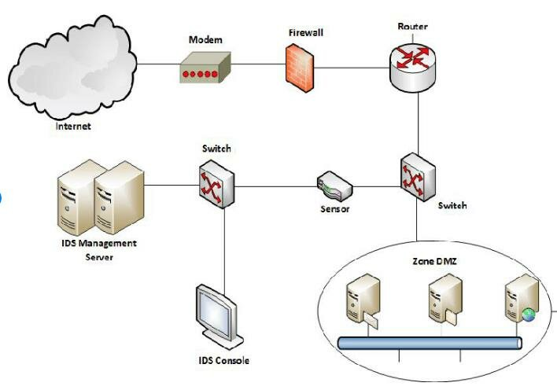
Future Enhancements
We plan to enhance our model by integrating real-time detection capabilities for packets generated by network devices and applications as they enter the network. Additionally, we aim to scale the system for large-scale deployment and commercialize it, enabling companies to leverage it for their operations.

Slide 22
References
Github
https://github.com/harshilpatel1799/IoT-Network-Intrusion-Detection-and-Classification-using-Explainable-XAI-Machine-Learning?tab=readme-ov-file
https://github.com/noushinpervez/Intrusion-Detection-CICIDS2017
Papers
https://www.unb.ca/cic/datasets/ids-2017.html

